Slide 1
Commercializing ORNL’s DT Cryogenic Pellet Injection System
July 13, 2026
Larry R. Baylor
FFESD

Slide 2
Commercializing ORNL’s smartGIScavp
Opportunity/Technology Description
Market Opportunity and Expected Impact
Problem addressed: Research teams and government labs need to rapidly prototype multi-page, data-driven web applications (dashboards, GIS maps, data tables) but lack front-end engineering capacity. Manual UI development takes weeks and creates a bottleneck between data science and stakeholder delivery.
Technical description: NSRD GIS Builder is a self-hosted, AI-powered React application generator. Users describe pages in plain English, optionally attach CSV data or SVG mockups, and a two-model LLM pipeline (Thinker + Coder) generates, builds, and deploys a live multi-page React app with Leaflet maps, charts, and tables. The system uses RAG (FAISS + sentence-transformers) over a golden-example codebase to inject proven patterns into every prompt.
Core components: React 18 / TypeScript frontend, Express.js backend with SSE streaming, Vite-based project scaffolding, automated build-fix retry loop, NGINX reverse proxy, Docker Compose orchestration, and a persistent RAG microservice (Python/FastAPI).
Development stage: Fully functional prototype deployed at demo2.recoil.ise.utk.edu, used internally by ORNL research teams.
Fundamental advantage: End-to-end automation from natural-language requirements to a deployed, production-quality React application in minutes rather than weeks.
Who has the problem now: National laboratories, university research groups, government agencies, and defense programs that produce large datasets but lack dedicated front-end developers to build interactive dashboards and GIS visualizations.
Current solutions & gap: Existing tools (Streamlit, Gradana, Retool) offer widget-based dashboards but cannot generate full multi-page React apps with custom maps, routing, and production builds. Manual development requires hiring front-end engineers. They are not specialized for geospatial data analysis
Quantify technical deltas: Reduces app creation from 2-4 weeks to under 10 minutes. Supports 3 page types (Home, Base, Geo/Map) with automatic CSV column detection, Leaflet integration, and responsive layouts. Two-model pipeline (Thinker + Coder) with automated build-fix loops achieves first-attempt success rates above 80%.
Applications (rough order): (1) ORNL internal research dashboards, (2) DOE environmental and energy program portals, (3) defense/intelligence rapid prototyping, (4) commercial SaaS for non-technical teams.
Licensing pathway (recommendation): Internal ORNL deployment first, then DOE-wide shared service, followed by CRADA or option-to-license for commercial partners.
Go-to-Market Plan and Technical Development Plan
Value Proposition and Deployment Plan
Months 1-3 (internal validation): Expand pilot with 3-5 ORNL divisions; collect user feedback on page types, model quality, and build success rates; harden Docker deployment and CI/CD pipeline; publish internal technology listing.
Months 2-8 (technical development):
• Validate RAG pipeline accuracy (FAISS + sentence-transformers) across 50+ golden examples; add new page types (charts, forms, admin panels).
• Integrate additional LLM backends (Anthropic Claude, OpenAI GPT-4o) alongside self-hosted Ollama (Llama, Qwen, DeepSeek, Mistral, Code Llama).
• Build multi-user project management, authentication, and role-based access control.
Months 6-12 (go-to-market):
• Package as a turnkey Docker appliance for DOE labs and defense customers.
• Publish case studies, host technical webinars, and present at DOE/ORNL tech transfer events.
• Negotiate CRADA partnerships with 1-2 commercial integrators.
Expected outcomes: A production-ready platform generating full-stack React applications from natural language, with documented API, user guide, and deployment automation.
Key risks: LLM output quality variability; build-fix loop edge cases; dependency on Ollama uptime; limited page-type coverage for complex enterprise UIs.
Alternatives: Streamlit (Python-only, no React output); Retool/Appsmith (widget-based, no code generation); manual front-end development (slow, expensive); ChatGPT/Copilot (generates snippets, not deployable apps).
Why better: NSRD GIS Builder produces complete, deployable multi-page React applications with routing, Leaflet maps, data tables, and responsive CSS from a single natural-language prompt. The RAG-augmented two-model pipeline ensures high code quality, and the automated build-fix loop handles compilation errors without user intervention.
Integration challenge: Low-Medium. Fully containerized (Docker Compose), single-port deployment behind NGINX. Requires only an Ollama-compatible LLM endpoint. No external database needed; projects persist in Docker volumes.
Private-sector partners: Cloud infrastructure providers; defense contractors needing rapid dashboard prototyping; GIS/mapping companies; DOE contractor organizations.
End users/customers: ORNL researchers and program managers; DOE environmental monitoring teams; university data science labs; defense and intelligence analysts needing rapid data visualization.
Deployment: Docker Compose on any Linux/Windows host. Production instance at demo2.recoil.ise.utk.edu:8432. NGINX reverse proxy with Let's Encrypt SSL. Persistent volumes for projects and RAG cache.

Slide 3
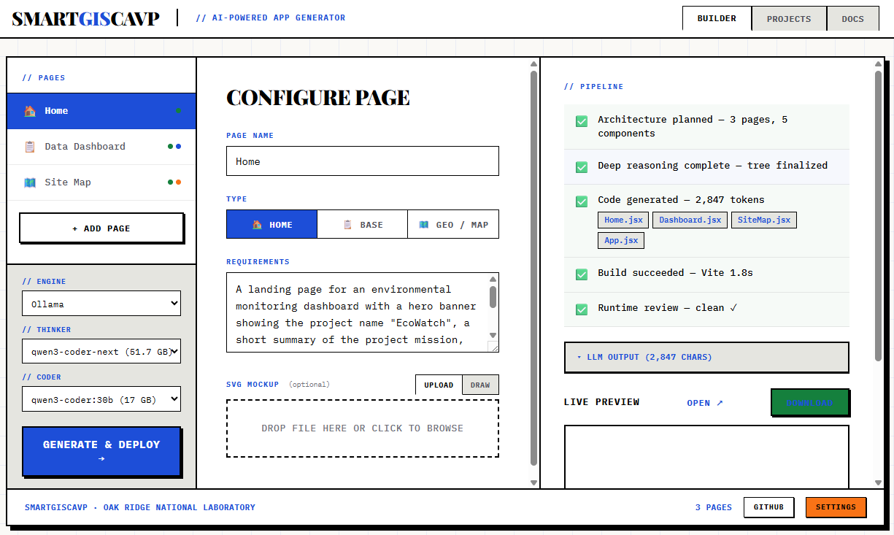
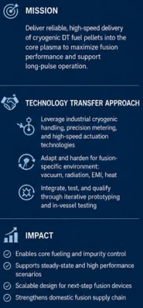
ORNL has pioneered with an automated interface for smart generation of dashboards based on paired RAG + LLMs

Slide 4
Preliminary Budget and Timeline
Go/No go Decision
Duration: Technology Innovation Program (TIP) funding is provided in annual rounds. Year 2 funding will be made available for the top performing project(s) from Year 1 that result in technology IP licenses.
¹Type: Identify the funded work or purchases (%FTE, others² , supplies, equip., materials, travel, computers and computing equipment³). Additional details in notes windows.
⁴Overhead: Apply normal org burden, but do not apply laboratory overhead.
Notes:
Duration: Technology Innovation Program (TIP) funding is provided in annual rounds. Year 2 funding will be made available for the top performing project(s) from Year 1 that result in technology IP licenses.
¹Type: Identify the funded work or purchases (%FTE, others² , supplies, equip., materials, travel, computers and computing equipment³)
²Others: If several investigators are contributing services at a minor level group them as “Others”.
³Computing equipment: Estimate the budget of computing equipment needed for successful completion of the project. Computers for general needs cannot be purchased with TIP funds.
⁴Overhead: Apply normal org burden, but do not apply laboratory overhead.

